Slide 1

Credit Card Lead Prediction
Team members :-
Ruthwik Ranganath Bethapudi
Sai Likitha Gavirneni
Shaili Gunda
Surya Naga Vinay Bhushan Vinjamuri
Venkata Sai Madhav Vellanki

Slide 2
CONTENTS
Project Introduction
Data Description
Data Pre-Processing
Exploratory data analysis
Machine Learning Models
Conclusion

Slide 3
PROJECT INTRODUCTION
CONTEXT
Building supervised machine algorithm models to assess individual data and predict whether a person is likely to purchase a credit card.
Project Motivation
The bank is interested in finding out which consumers would have a higher likelihood of using a suggested credit card.
Bank hopes to upsell its credit cards to current clients. A certain group of consumers who are qualified to use these credit cards has been identified by the bank.
The bank needs your assistance to identify clients who could be more likely to exhibit interest in a suggested credit card.
Target Audience
Our aim is to find people who are likely to purchase a credit card.

Slide 4
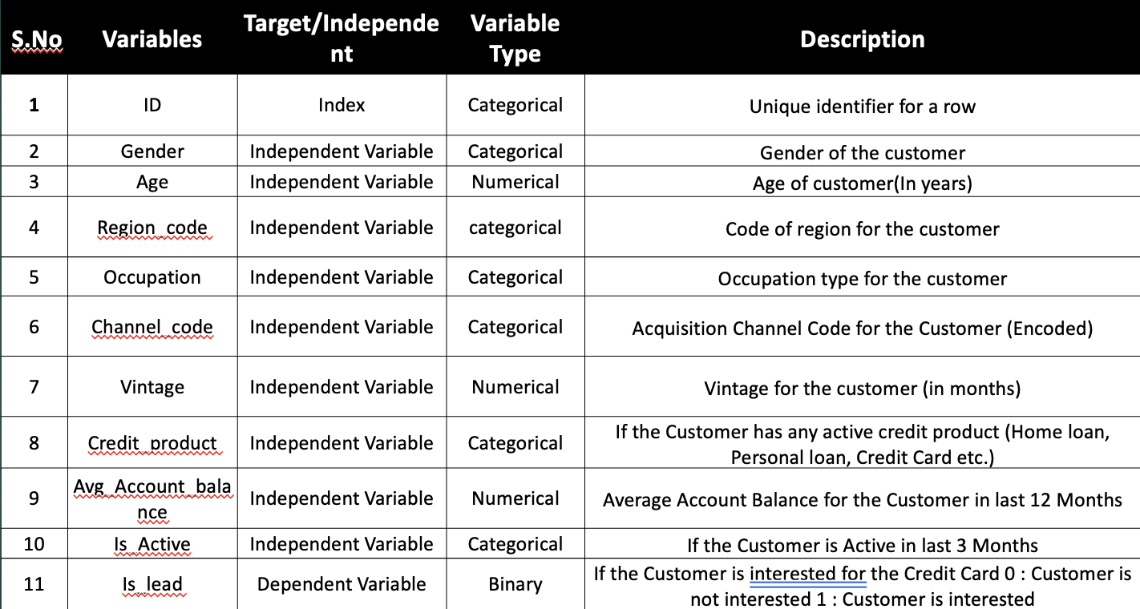
Data Description
Target Variable – Is_Lead
10 Predictors – 3 Numerical variables & 7 Categorical variables

Slide 5
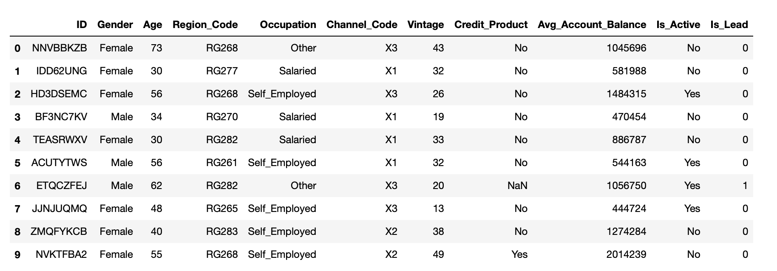
Data analysis and preprocessing
245725 records
Data Cleaning
Outlier Treatment

Slide 6
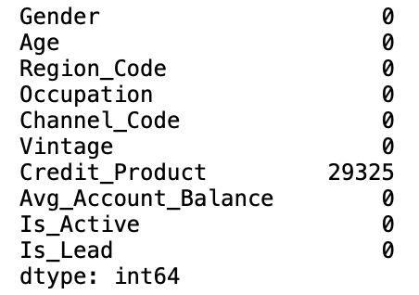
Handling null values
Imputation is a method used for replacing the missing values with an alternate to retain most of the data/information
Without Imputation
Critical records may be deleted.
Reduction in the data set size
Outcome: Bridge the gap and provide reliable results
Imputation Methods : Most frequent.

Slide 7
Exploratory Data Analysis

Slide 8
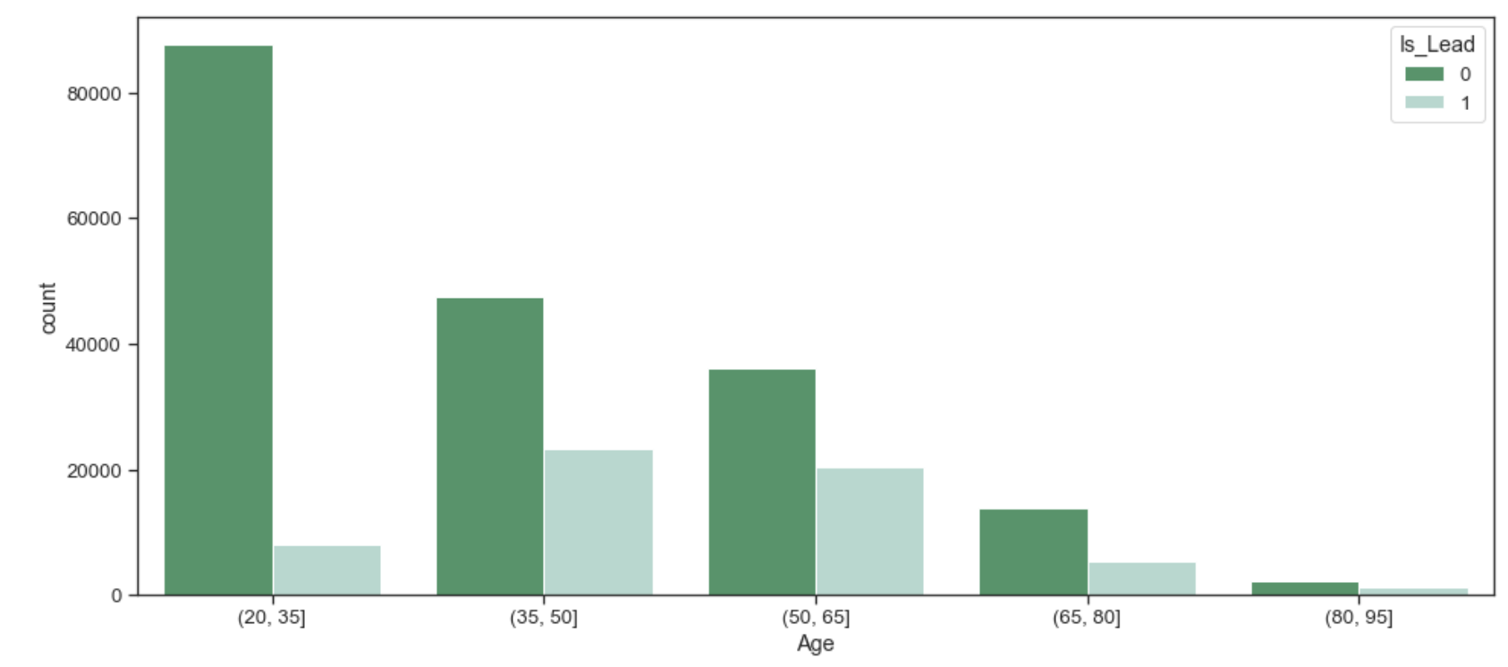
Performed EDA on age variable vs target variable
Age group [35,50] are most likely to show interest in taking a credit card.
Age group [80,95] are least likely to show interest in taking a credit card.

Slide 9
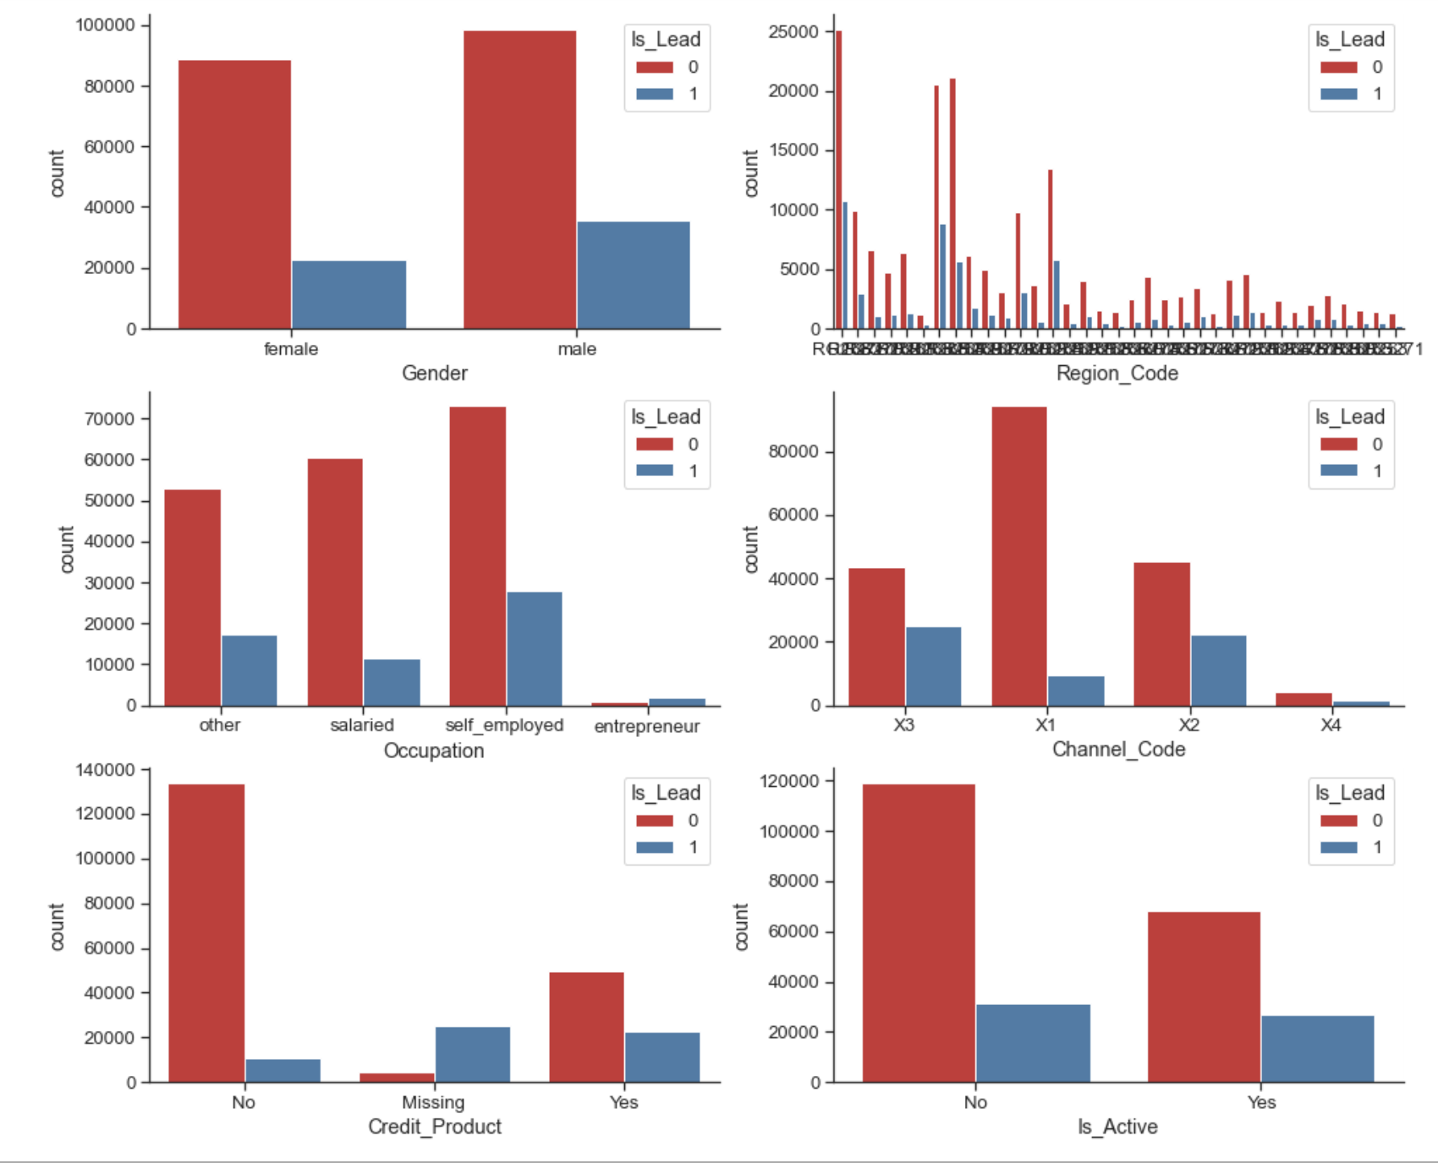
Visualization of count vs gender, occupation, region_code, channel_code, credit_product,Is_active.
Male are most likely to convert.
Social media marketing (x2) has highest conversion rate.
Self employed people are most likely to take credit cards compared to other occupation people.
It is very strange to observe that the missing values do actually have more leads.
Thus we shall impute the missing values as 'Missing’ with most frequent class.

Slide 10
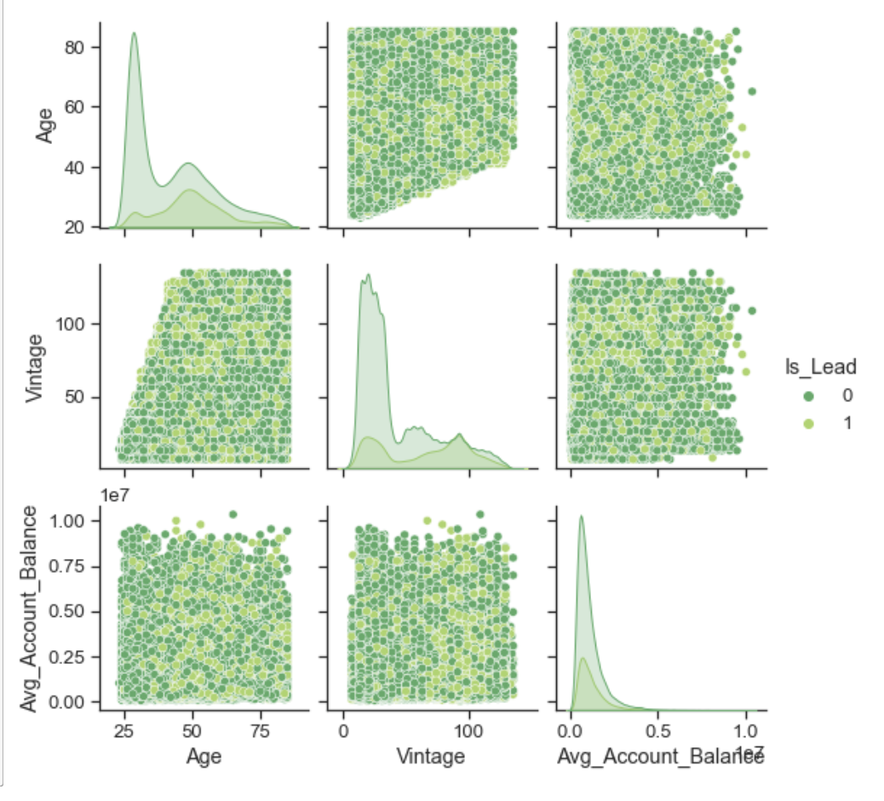
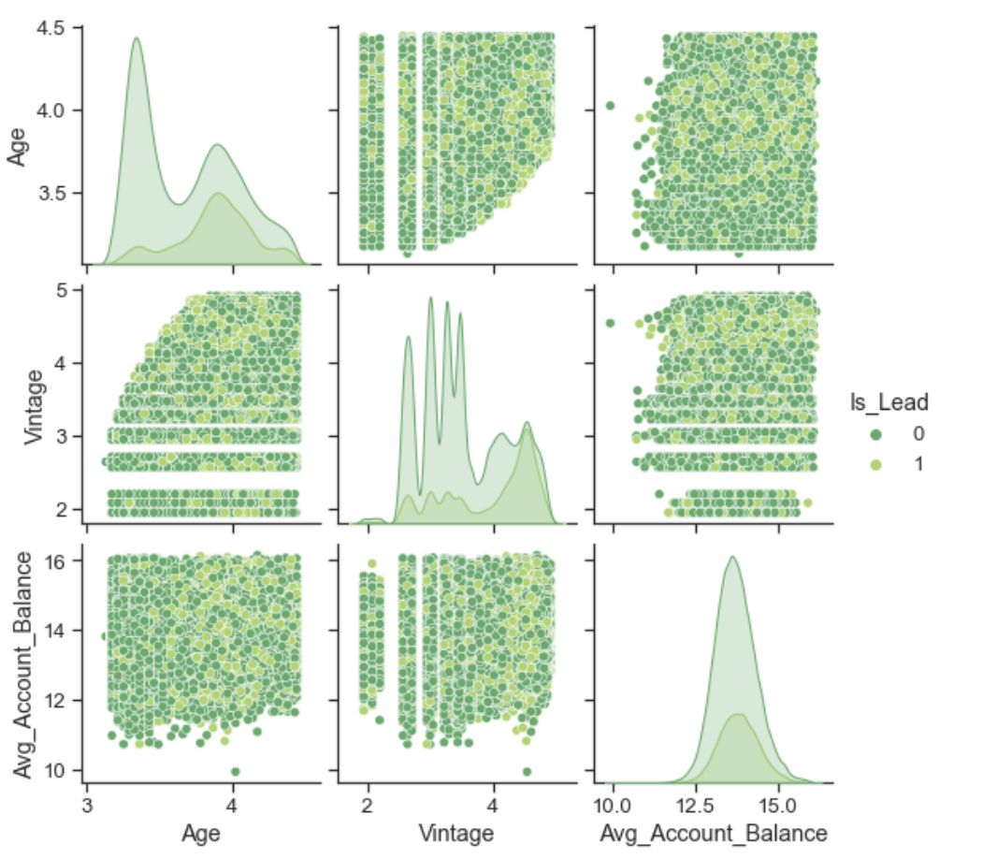
We shall proceed with taking log transform of 'Avg_Account_Balance' to obtain normal distribution.

Slide 11
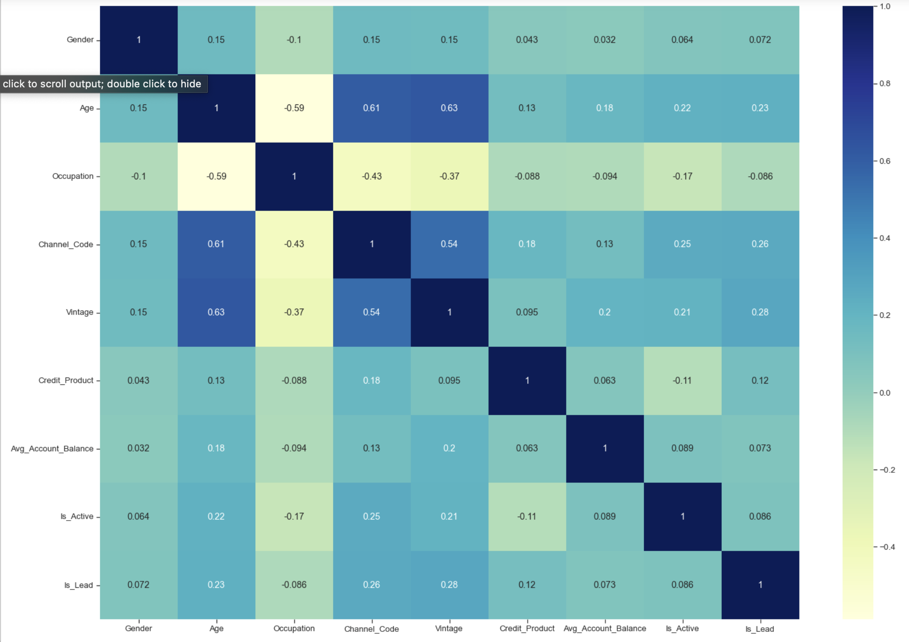
Correlation plot
We are looking for high correlation between the predictors.
We can observe that there is no larger correlation between any of the variables.

Slide 12
Machine learning models

Slide 13
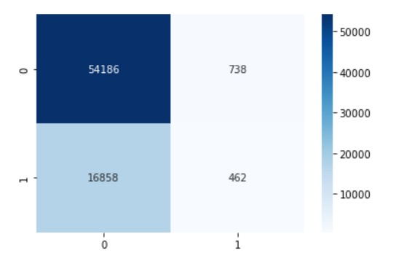
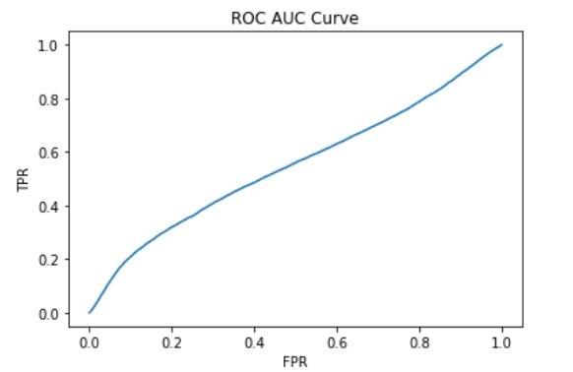
Logistic Regression

Slide 14
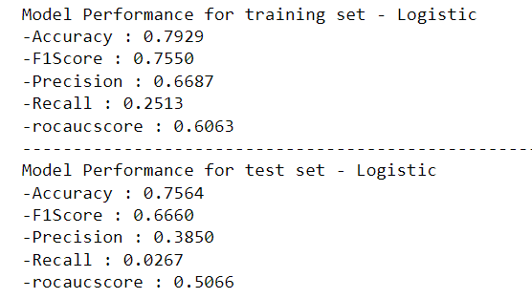
LOGISTIC REGRESSION performance metrics

Slide 15
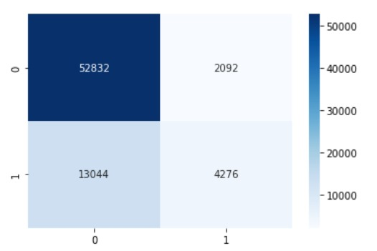
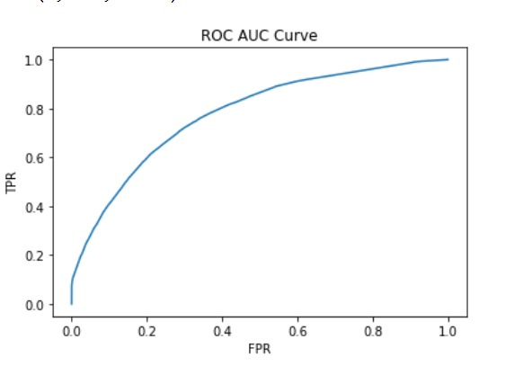
Decision tree

Slide 16
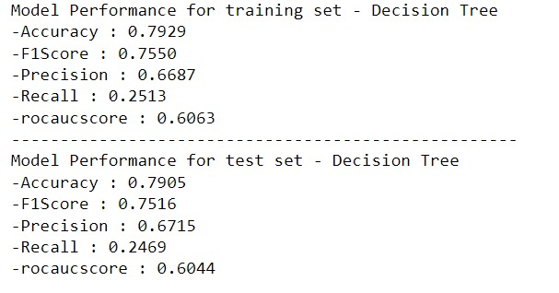
Decision Tree performance metrics

Slide 17
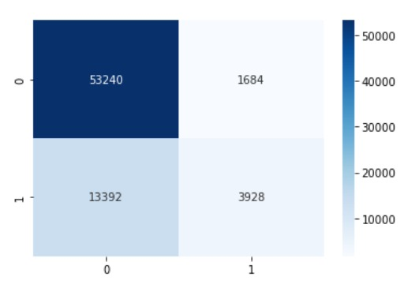
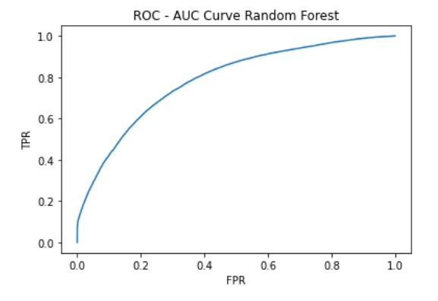
Random forest

Slide 18
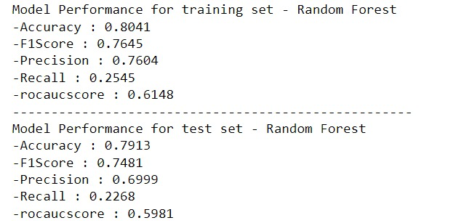
Performance metrics Random Forest

Slide 19
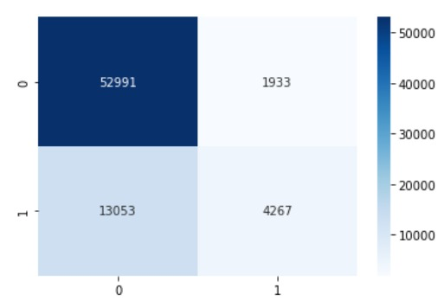
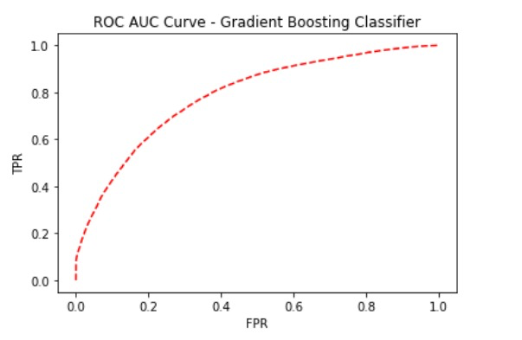
Gradient boosting

Slide 20
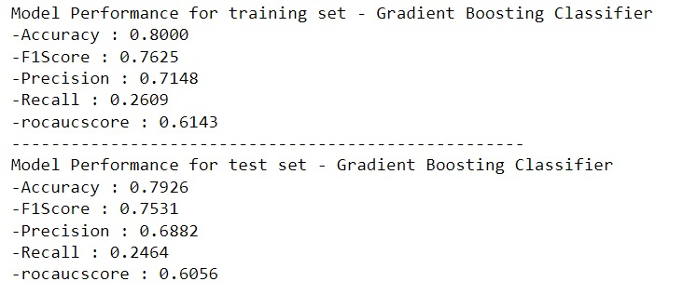
Performance metrics - GDBC

Slide 21
conclusion
Model Used | F1 score
Logistic Regression | 0.6660
Decision Tree | 0.7516
Random Forest | 0.7481
Gradient Boosting Classifier | 0.7531
Here, we select the model in which both false positive and false negative are undesired for the business. Hence, F1 score will be the key performance indicator in determining the best model.
We conclude Gradient Boosting Classifier as the best model.

Slide 22
End OF presentation

